Slide 1

Stack & Queue

Slide 2
Stacks and queues
Some collections are constrained so clients can only use optimized operations
stack: retrieves elements in reverse order as added
queue: retrieves elements in same order as added
push
pop, peek
top | 3
 | 2
bottom | 1
front |  | back
1 | 2 | 3
remove, peek
add
queue
stack

Slide 3
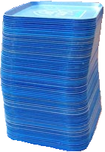
Stacks
stack: A collection based on the principle of adding elements and retrieving them in the opposite order.
Last-In, First-Out ("LIFO")
Elements are stored in order of insertion.
We do not think of them as having indexes.
Client can only add/remove/examine the last element added (the "top").
basic stack operations:
push: Add an element to the top.
pop: Remove the top element.
peek: Examine the top element.
push
pop, peek
top | 3
 | 2
bottom | 1
stack
Notes:
analogy: trays of food at the sizzler

Slide 4
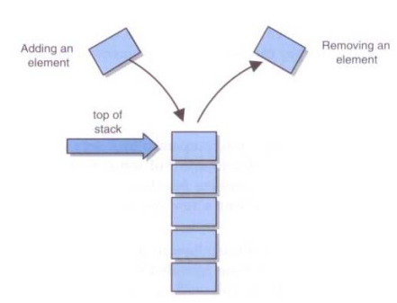
Conceptual View of S

Slide 5
Stacks in computer science
Programming languages and compilers:
method calls are placed onto a stack (call=push, return=pop)
compilers use stacks to evaluate expressions
Matching up related pairs of things:
find out whether a string is a palindrome
examine a file to see if its braces { } match
convert "infix" expressions to pre/postfix
Sophisticated algorithms:
searching through a maze with "backtracking"
many programs use an "undo stack" of previous operations
method3 | return var local vars parameters
method2 | return var local vars parameters
method1 | return var local vars parameters

Slide 6
Class Stack
Stack<E>() | constructs a new stack with elements of type E
push(value) | places given value on top of stack
pop() | removes top value from stack and returns it; throws EmptyStackException if stack is empty
peek() | returns top value from stack without removing it; throws EmptyStackException if stack is empty
size() | returns number of elements in stack
isEmpty() | returns true if stack has no elements
Stack<String> s = new Stack<String>();
s.push("a");
s.push("b");
s.push("c"); // bottom ["a", "b", "c"] top
System.out.println(s.pop()); // "c"

Slide 7
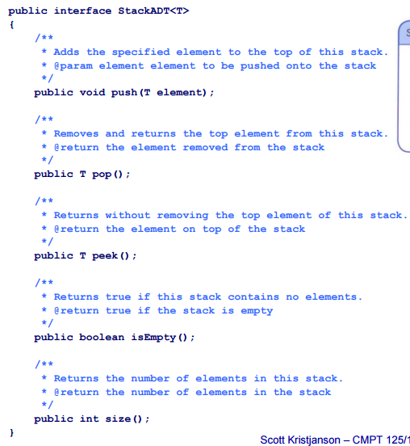

Slide 8
Collections of primitives
The type parameter specified when creating a collection (e.g. ArrayList, Stack, Queue) must be an object type
// illegal -- int cannot be a type parameter
Stack<int> s = new Stack<int>();
ArrayList<int> list = new ArrayList<int>();
Primitive types need to be "wrapped" in objects
// creates a stack of ints
Stack<Integer> s = new Stack<Integer>();

Slide 9
Wrapper classes
Primitive Type | Wrapper Type
int | Integer
double | Double
char | Character
boolean | Boolean
Wrapper objects have a single field of a primitive type
The collection can be used with familiar primitives:
ArrayList<Double> grades = new ArrayList<Double>();
grades.add(3.2);
grades.add(2.7);

Slide 10
Stack limitations/idioms
You cannot loop over a stack in the usual way.
Stack<Integer> s = new Stack<Integer>();
...
for (int i = 0; i < s.size(); i++) {
do something with s.get(i);
}
Instead, you pull elements out of the stack one at a time.
common idiom: Pop each element until the stack is empty.
// process (and destroy) an entire stack
while (!s.isEmpty()) {
do something with s.pop();
}

Slide 11
public static void max(Stack<Integer> s) {
int maxValue = s.pop();
while (!s.isEmpty()) {
int next = s.pop();
maxValue = Math.max(maxValue, next);
}
return maxValue;
}

Slide 12
Error checking
There are two stack errors that can occur:
Underflow: trying to pop (or peek at) an empty stack
Overflow: trying to push onto an already full stack
For underflow, you should throw an exception
If you don’t catch it yourself, Java will throw an ArrayIndexOutOfBounds exception
You could create your own, more informative exception
For overflow, you could do the same things
Or, you could check for the problem, and copy everything into a new, larger array

Slide 13
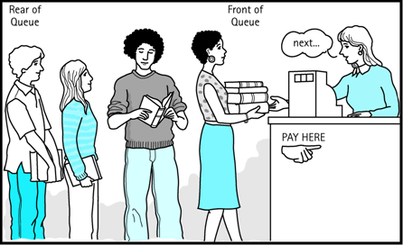
Queues
queue: Retrieves elements in the order they were added.
First-In, First-Out ("FIFO")
Elements are stored in order of insertion but don't have indexes.
Client can only add to the end of the queue, and can only examine/remove the front of the queue.
basic queue operations:
add (enqueue): Add an element to the back.
remove (dequeue): Remove the front element.
peek: Examine the front element.
front |  | back
1 | 2 | 3
remove, peek
add
queue
Notes:
analogy: trays of food at the sizzler

Slide 14
Queues in computer science
Operating systems:
queue of print jobs to send to the printer
queue of programs / processes to be run
queue of network data packets to send
Programming:
modeling a line of customers or clients
storing a queue of computations to be performed in order
Real world examples:
people on an escalator or waiting in a line
cars at a gas station (or on an assembly line)

Slide 15
Programming with Queues
add(value) | places given value at back of queue
remove() | removes value from front of queue and returns it; throws a NoSuchElementException if queue is empty
peek() | returns front value from queue without removing it; returns null if queue is empty
size() | returns number of elements in queue
isEmpty() | returns true if queue has no elements
Queue<Integer> q = new LinkedList<Integer>();
q.add(42);
q.add(-3);
q.add(17); // front [42, -3, 17] back
System.out.println(q.remove()); // 42
IMPORTANT: When constructing a queue you must use a new LinkedList object instead of a new Queue object.
This has to do with a topic we'll discuss later called interfaces.

Slide 16
Mixing stacks and queues
We often mix stacks and queues to achieve certain effects.
Example: Reverse the order of the elements of a queue.
Queue<Integer> q = new LinkedList<Integer>();
q.add(1);
q.add(2);
q.add(3); // [1, 2, 3]
Stack<Integer> s = new Stack<Integer>();
while (!q.isEmpty()) { // Q -> S
s.push(q.remove());
}
while (!s.isEmpty()) { // S -> Q
q.add(s.pop());
}
System.out.println(q); // [3, 2, 1]

Slide 17
Exercises
Write a method stutter that accepts a queue of integers as a parameter and replaces every element of the queue with two copies of that element.
front [1, 2, 3]
becomes front [1, 1, 2, 2, 3, 3]
Write a method mirror that accepts a queue of strings as a parameter and appends the queue's contents to itself in reverse order.
front [a, b, c]
becomes front [a, b, c, c, b, a]

